Slide 1

ICCAT Workshop: investigation into bycatch estimation methodologies
Module 2B: Model-based approaches to bycatch estimation
Facilitators:
Dr. Beth Babcock
Dr. Ana Adao

Slide 2
Model-based estimators
Model-based estimation:
Mean CPUE of observed sample units (e.g. trips or sets) is estimated from a linear model with predictor variables
e.g. Negative binomial GLM
Log(CPUE)= year+season+area+depth
No need to impute missing strata, unless the model includes interactions

Slide 3

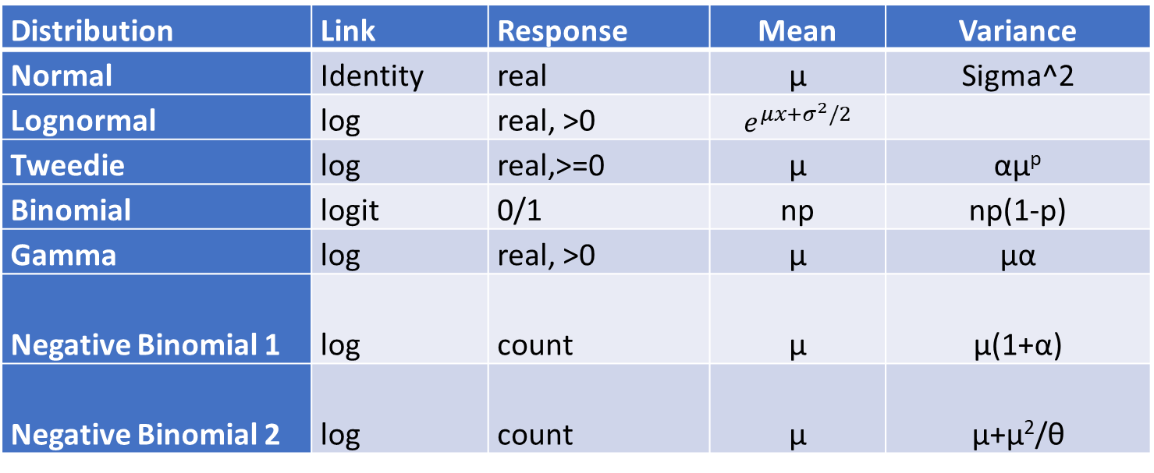
Observation error models
Distribution | Link | Response | Mean | Variance
Normal | Identity | real | μ | Sigma^2
Lognormal | log | real, >0 | $e^{μx+σ^{2}/2}$
Tweedie | log | real,>=0 | μ | αμ^{p}
Binomial | logit | 0/1 | np | np(1-p)
Gamma | log | real, >0 | μ | μα
Negative Binomial 1 | log | count | μ | μ(1+α)
Negative Binomial 2 | log | count | μ | μ+μ²/θ
Notes:
Variance of lognormal distribution: it shows up when in presenting mode

Slide 4
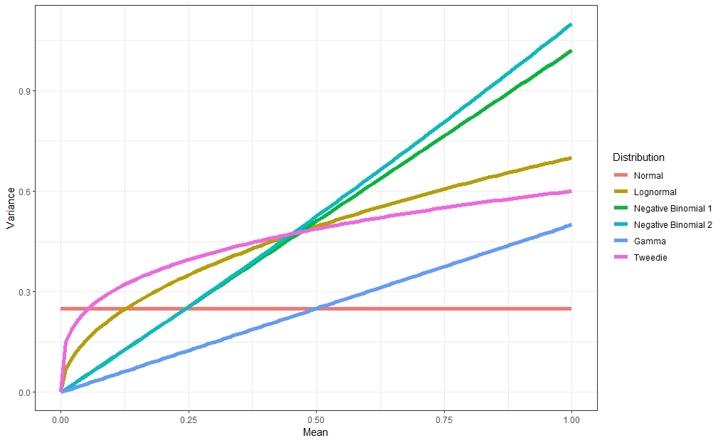
Variance vs. Mean

Slide 5
Observation error models – continuous response
Normal and lognormal models
Not expected to perform well with many zero bycatch observations, but included in R package for completeness
Normal and lognormal models in R package:
“Normal”, “Lognormal” (lm and glm functions)
“TMBnormal”, “TMBlognormal” (glmmTMB library)

Slide 6
Observation error models – continuous response
Tweedie models
Generalized function similar to a gamma distribution, except that it allows extra probability mass at zero
Appropriate for continuous data with extra zeros
Use a log link function for the mean, and estimates an index parameter p and a dispersion parameter Φ which determine the shape of the distribution
Tweedie models in the R package:
“Tweedie” (cplm library)
“TMBtweedie” (glmmTMB library)

Slide 7
Observation error models – delta models
Delta models: Delta-lognormal and delta-gamma
Two-part models, assume that zero and non-zero data arise from separate processes
A binomial model of the proportion of positive observations with a logit link GLM
Either a lognormal or gamma distribution models the positive/non-zero data
For the delta-lognormal, the CPUE is log transformed, and the mean CPUE is calculated for positive observations only
For the delta-gamma, the log link is used to model the positive CPUE values
The binomial by itself predicts the probability of a positive observation. Details of this model are also provided in outputs

Slide 8
Observation error models – delta models
Delta models in the bycatch estimator R package:
“TMBdelta-Lognormal”, “TMBdelta-Gamma” (glmmTMB library)
“Binomial” or “TMBbinomial” will be run automatically as part of the delta models if any of them are selected, and can also be run on their own

Slide 9
Observation error models – integer response
Negative binomial 1 and 2
Models integer counts, so it is appropriate for predicting bycatch in numbers (or weight if rounded)
The code rounds the catches to integers before running this model
Negative binomial model setup
To predict CPUE is necessary to include an offset in the model:
log(C_{i})=b₀+b₁x₁+offset(log(E_{i}))
Where C_{i} is the catch in trip i in the observed data, b₀+b₁x₁ is an example linear predictor with an intercept and slope, and the offset is the log of the effort E_{i} in each trip
BycatchEstimator sets this up automatically.

Slide 10
Observation error models – integer response
Negative binomial models in the bycatch estimator R package:
“NegBin” (glm.nb in MASS library)
“TMBnbinom1”, “TMBnbinom2” (glmmTMB library)
Difference between “TMBnbinom1” and “TMBnbinom2” is the calculation of variance = μ(1+α) for TMBnbinom1, and μ+μ²/θ for TMBnbinom2
"NegBin" and "TMBnbinom2" use same method for variance calculation and are the standard negative binomial

Slide 11
Observation error models - summary
Normal and lognormal models
Tweedie models: continuous response
Delta models (delta-lognormal, delta-gamma): for data with lots of zero observations
Negative binomial models: integer response (count data)
BycatchEstimator uses cross-validation to determine which observation error model best predicts CPUE

Slide 12
Model-based estimators
How is total bycatch calculated using each of the error models?
Catch per trip predicted directly by negative binomial models, with logbook effort as offset.
Tweedie and normal models predict CPUE, which is then multiplied by logbook effort
Delta-lognormal and delta-gamma models have separate components for the probability of a positive CPUE and the CPUE, which must be multiplied together and multiplied by logbook effort to get total catch with appropriate bias corrections

Slide 13
Model-based estimators
How is the variance of total bycatch calculated?
We are using the CPUE model to predict the catches in each unsampled trip. This is a prediction interval not a confidence interval
Strata are not independent in the predictions, because they are made from a model with correlation among the coefficients
Thus, when the unsampled catches are calculated from model, variance/covariance matrix among parameters needs to be incorporated.

Slide 14
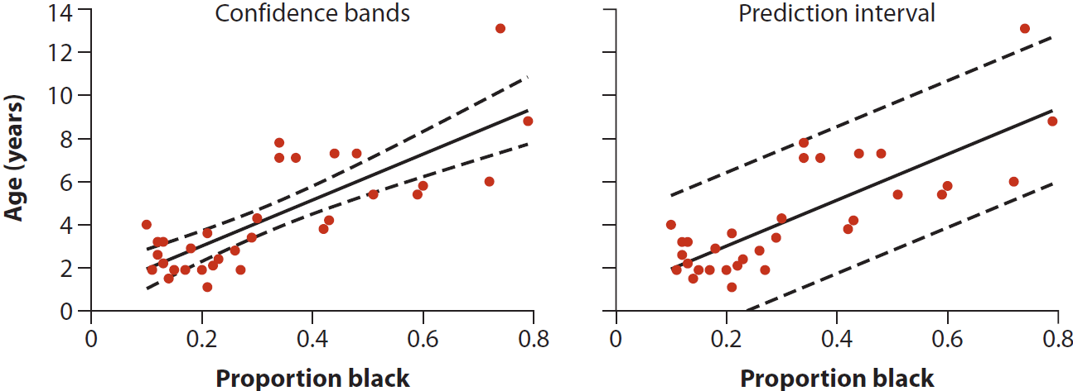
Confidence interval vs. prediction
Confidence interval variance is:
Variability of the predicted new y_{i} at any point x_{i} is:

Slide 15
Variance estimation methods
Delta method
Pre and post multiply the partial derivatives of the inverse link function to the variance covariance matrix of the predictions
Simulation method (Monte Carlo)
Draw values of the model coefficients from a multivariate normal, draw predicted catch from likelihood for unsampled sets/trips, sum both predicted catch and variance
Users may choose not to estimate variances for large logbook datasets where these methods will generate large matrices that are slow to calculate
Delta method and simulation produce similar variance estimates

Slide 16
Observed catches
The observed bycatch can be included as a known constant (particularly for high observer coverage), so the predicted bycatch and its variance would only be estimated for the unsampled effort.
Including observed catch as a known constant, requires matching observer and logbook trips to identify the unsampled effort
Including observed bycatch as a known constant reduces variance at higher observer coverage. At low coverage it doesn’t matter

Slide 17
Summary
Model-based estimators:
May be more precise
No need for complicated imputation schemes for unsampled strata (no pooling)
Not easy to pick the best observation error model and predictor variables
Variance calculation is not straightforward
Works better if you can match trips between observer and logbook data

Slide 18
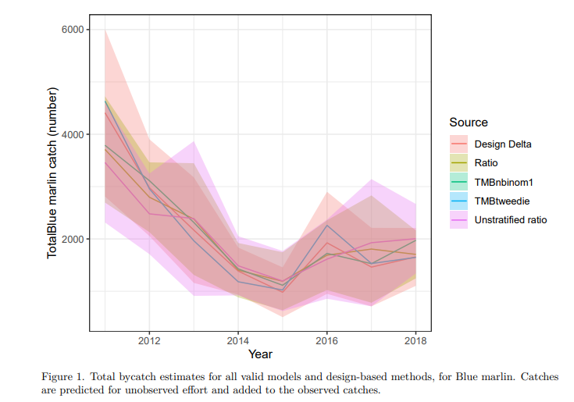
Comparison design-based vs model-based

